Slide 1
CORONA VIRUS
ANALYSIS
SQL(STRUCTURE QUERY LANGUAGE)

Slide 2
CONTENT
Project Overview
Dataset Description
Data Exploration and Analysis
Analysis(Query)
Summary

Slide 3
Project Overview
The coronavirus pandemic has had a significant impact on public health and has created an urgent need for data-driven insights to understand the spread of the virus.
The coronavirus pandemic has reshaped daily life globally. This analysis of coronavirus data using SQL aims to uncover key insights into its spread and demographic impacts. Join us to explore critical aspects of the pandemic and understand its implications for decision-making and response strategies.
As a data analyst, you have been tasked with analyzing a CORONA VIRUS dataset to derive meaningful insights and present your findings.

Slide 4
Dataset Description:
Province: Geographic subdivision within a country/region.
Country/Region: Geographic entity where data is recorded.
Latitude: North-south position on Earth's surface.
Longitude: East-west position on Earth's surface.
Date: Recorded date of CORONA VIRUS data.
Confirmed: Number of diagnosed CORONA VIRUS cases.
Deaths: Number of CORONA VIRUS related deaths.
Recovered: Number of recovered CORONA VIRUS cases.

Slide 5
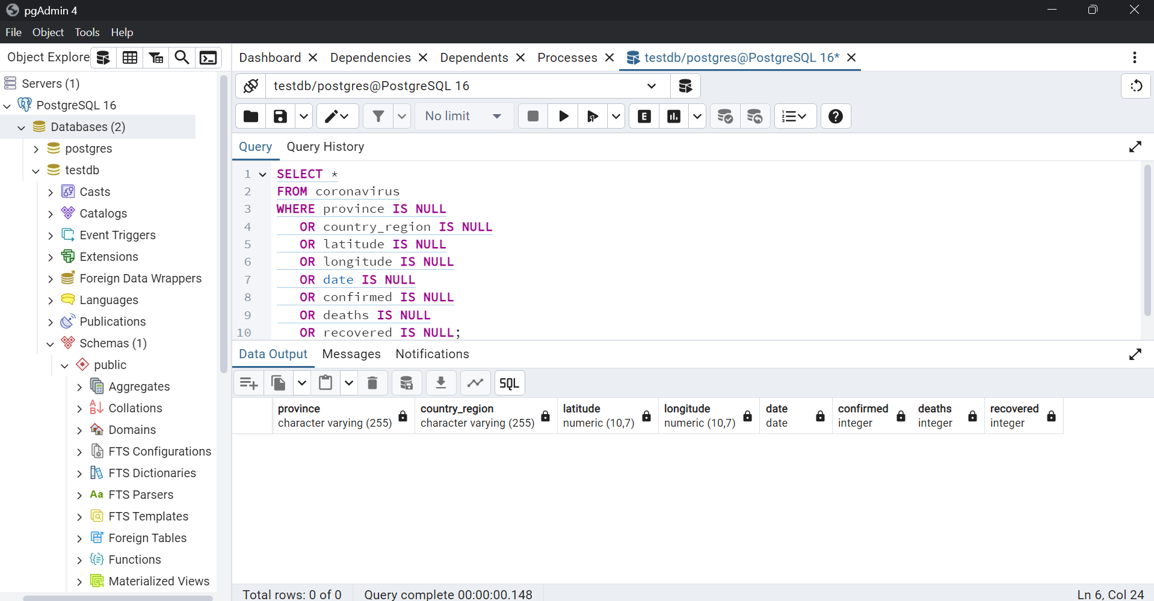
Data Exploration and Analysis:
Q1. Write a code to check NULL values

Slide 6
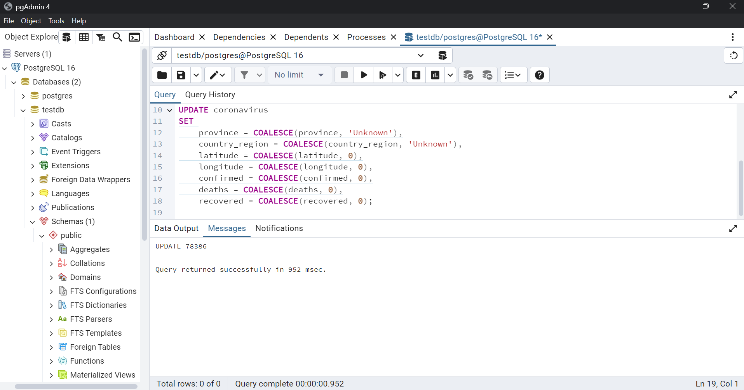
Q2. If NULL values are present, update them with zeros for all columns.

Slide 7
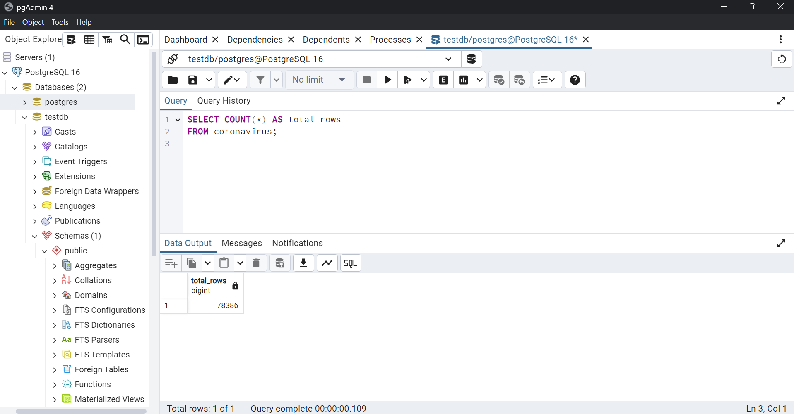
Q3. check total number of rows

Slide 8
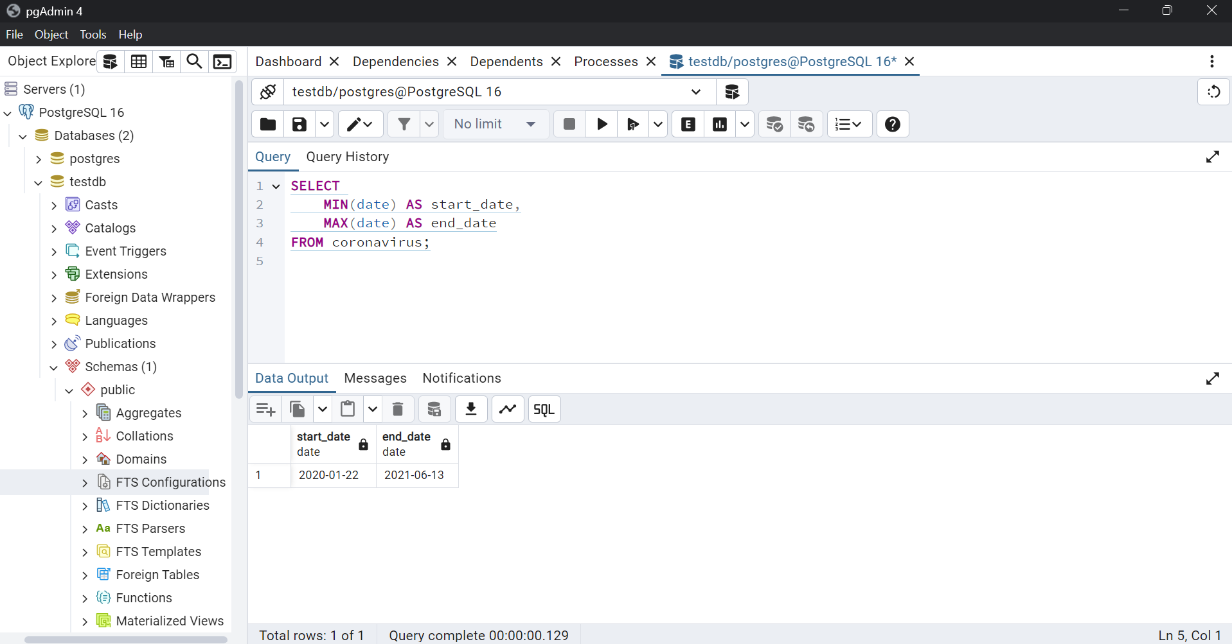
Q4. Check what is start_date and end_date

Slide 9
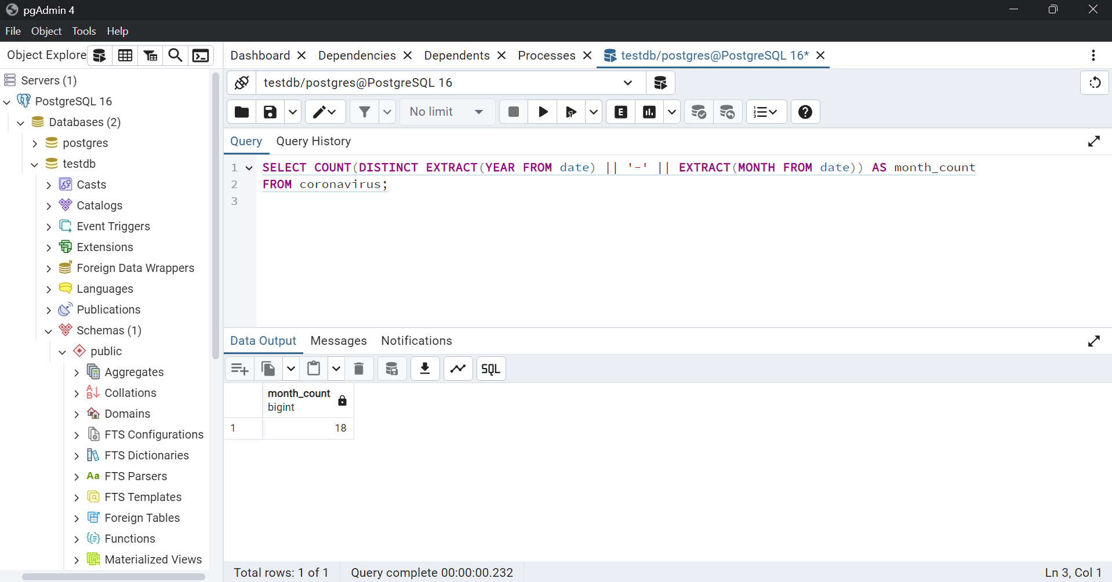
Q5. Number of month present in dataset

Slide 10
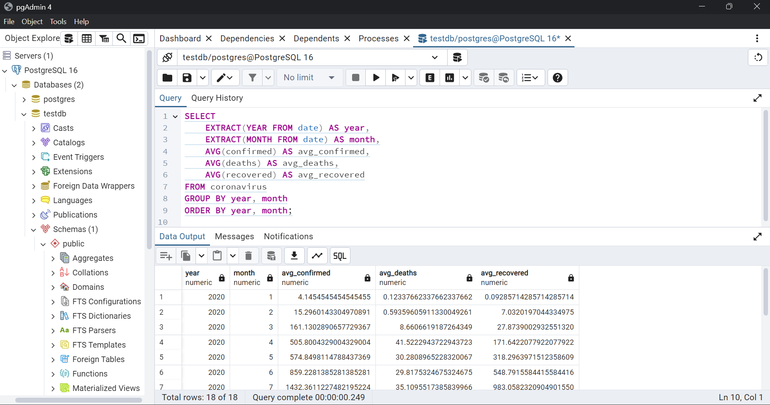
Q6. Find monthly average for confirmed, deaths, recovered

Slide 11
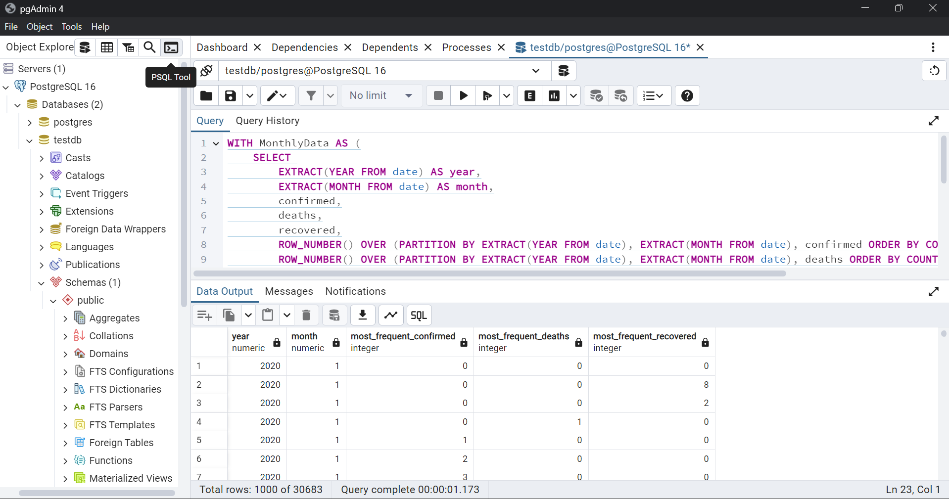
Q7. Find most frequent value for confirmed, deaths, recovered each month

Slide 12
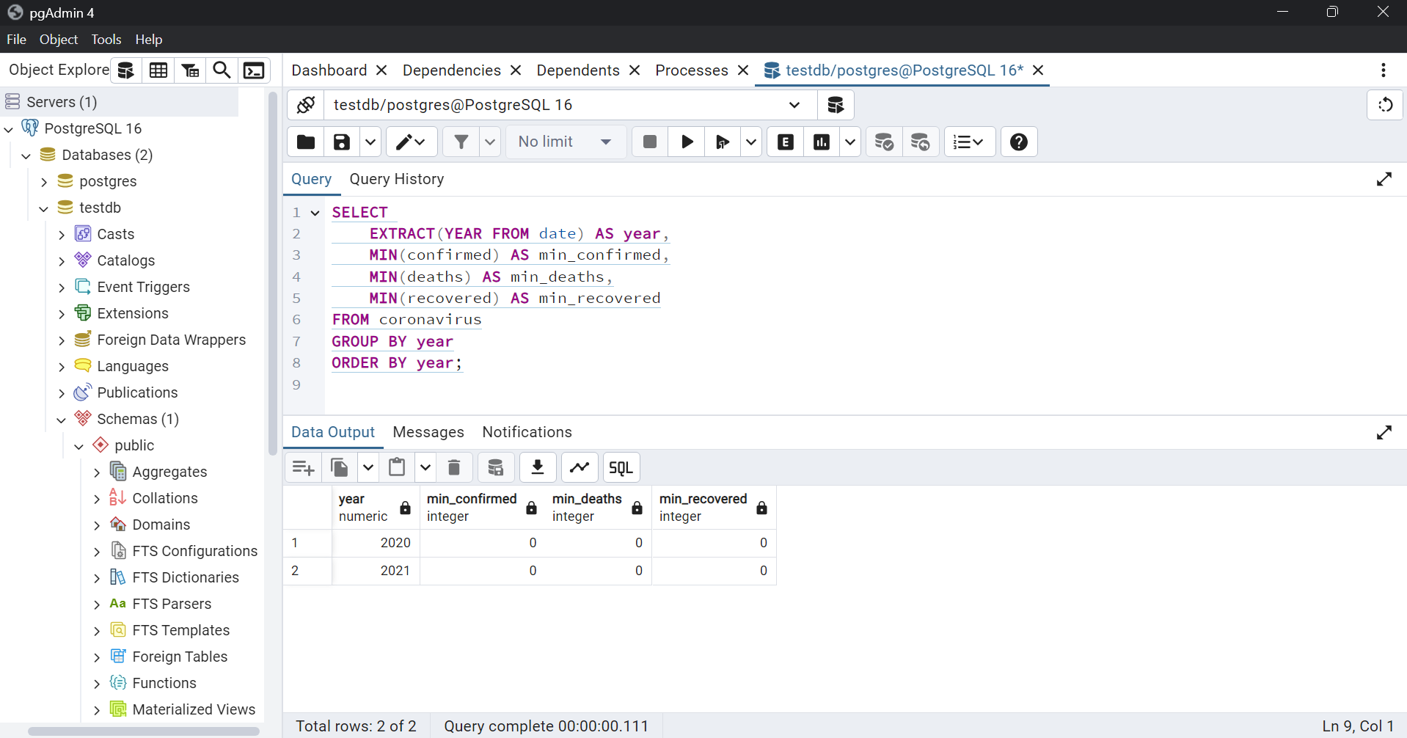
Q8. Find minimum values for confirmed, deaths, recovered per year

Slide 13
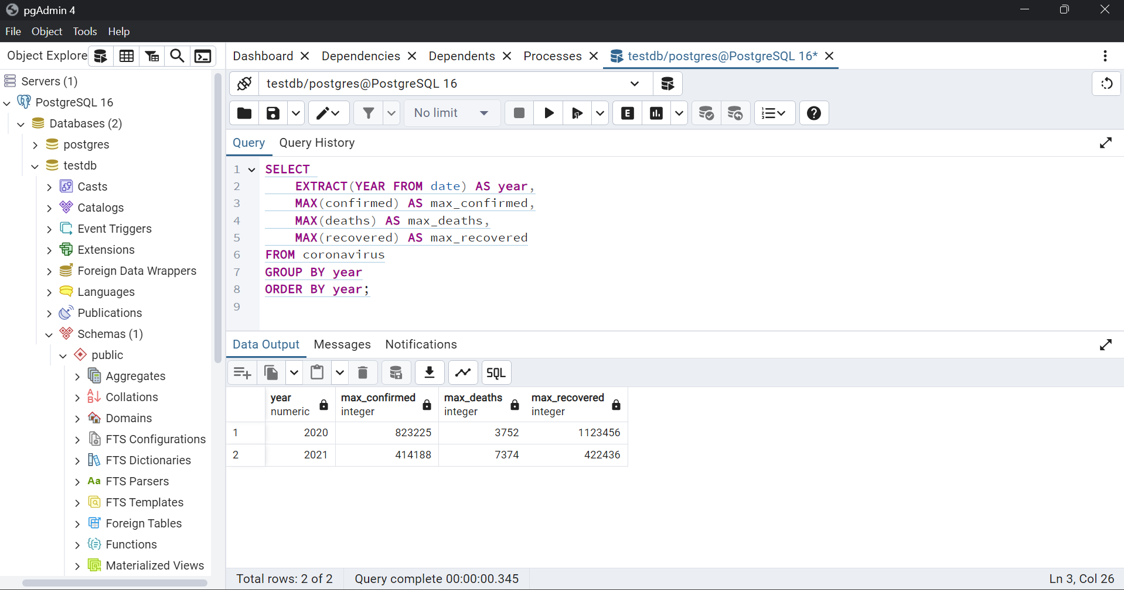
Q9. Find maximum values of confirmed, deaths, recovered per year

Slide 14
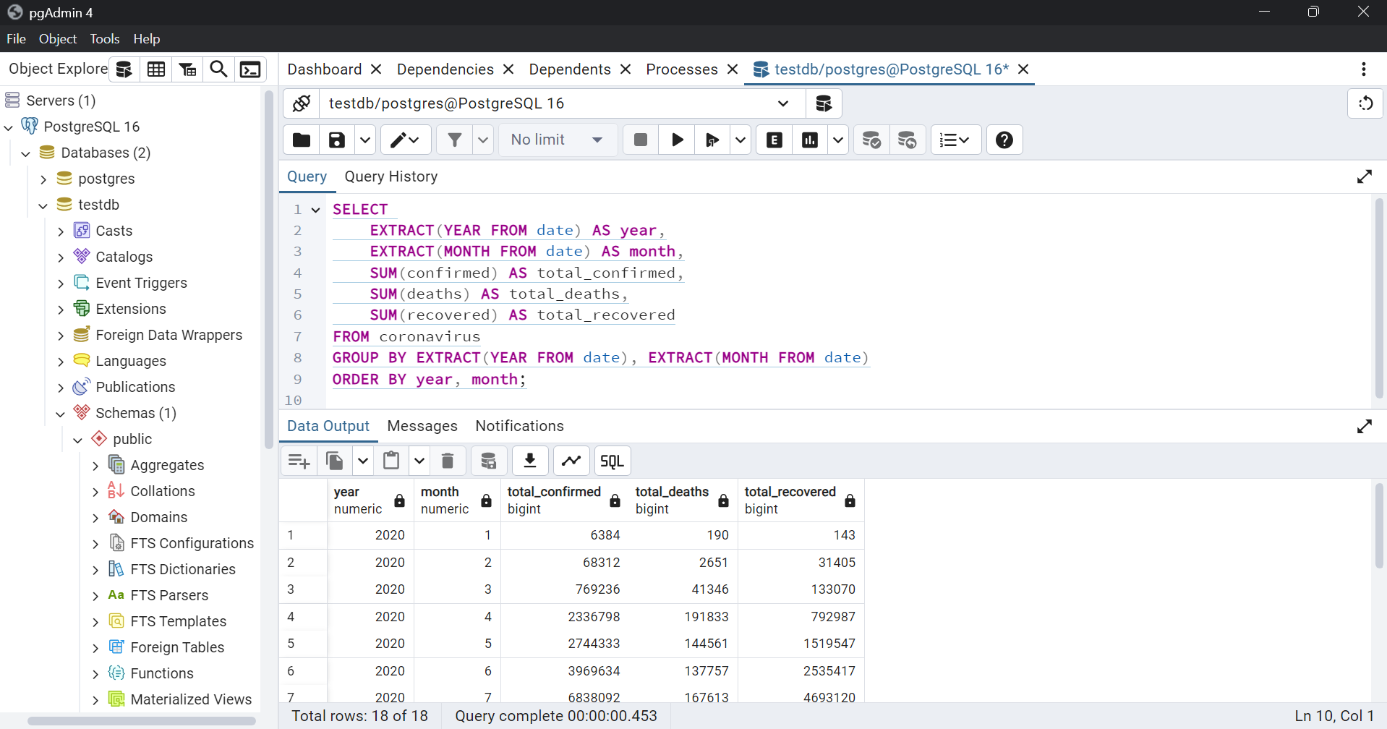
Q10. The total number of case of confirmed, deaths, recovered each month

Slide 15
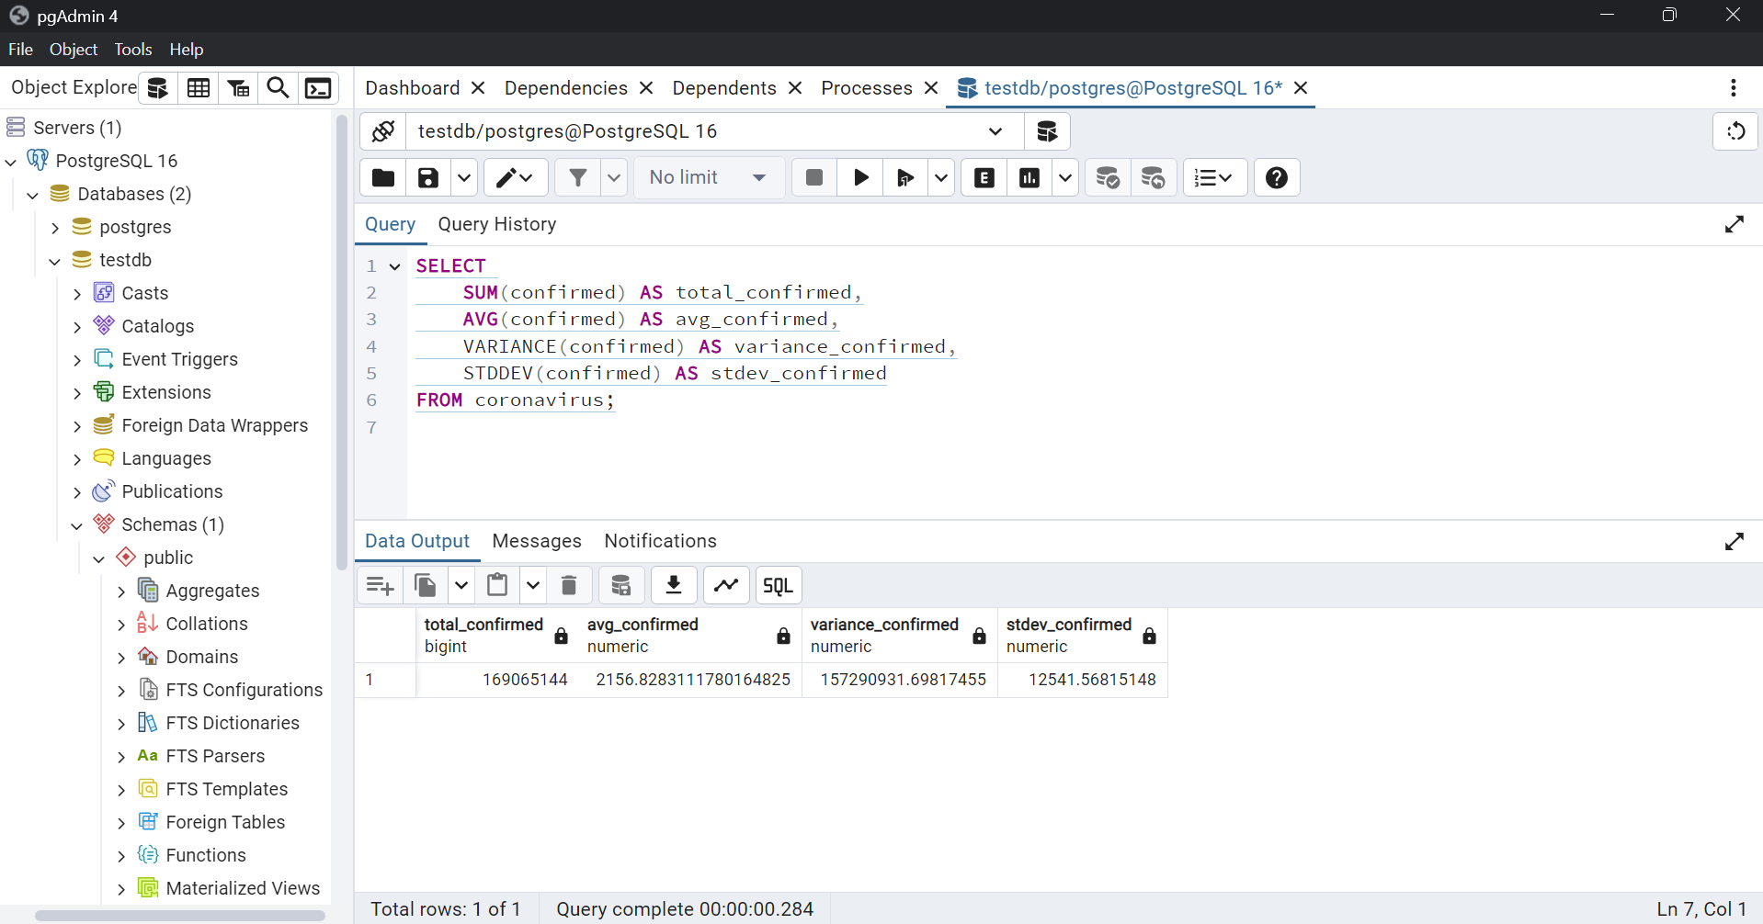
Q11. Check how corona virus spread out with respect to confirmed case

Slide 16
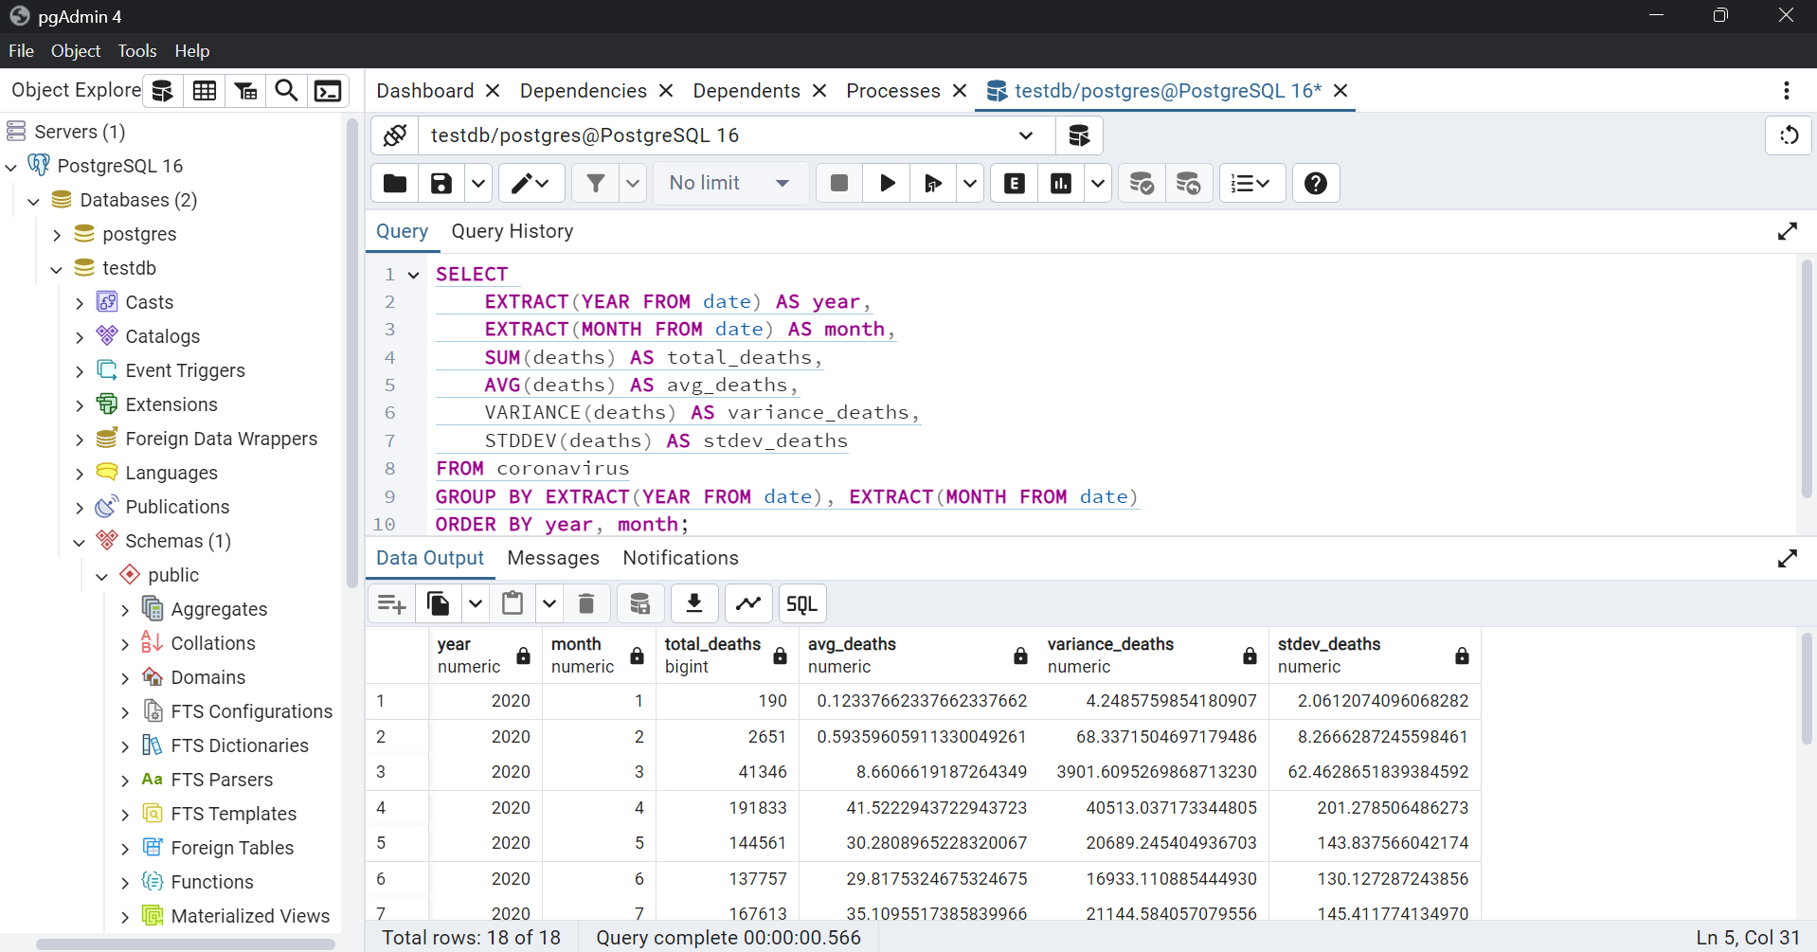
Q12. Check how corona virus spread out with respect to death case per month

Slide 17
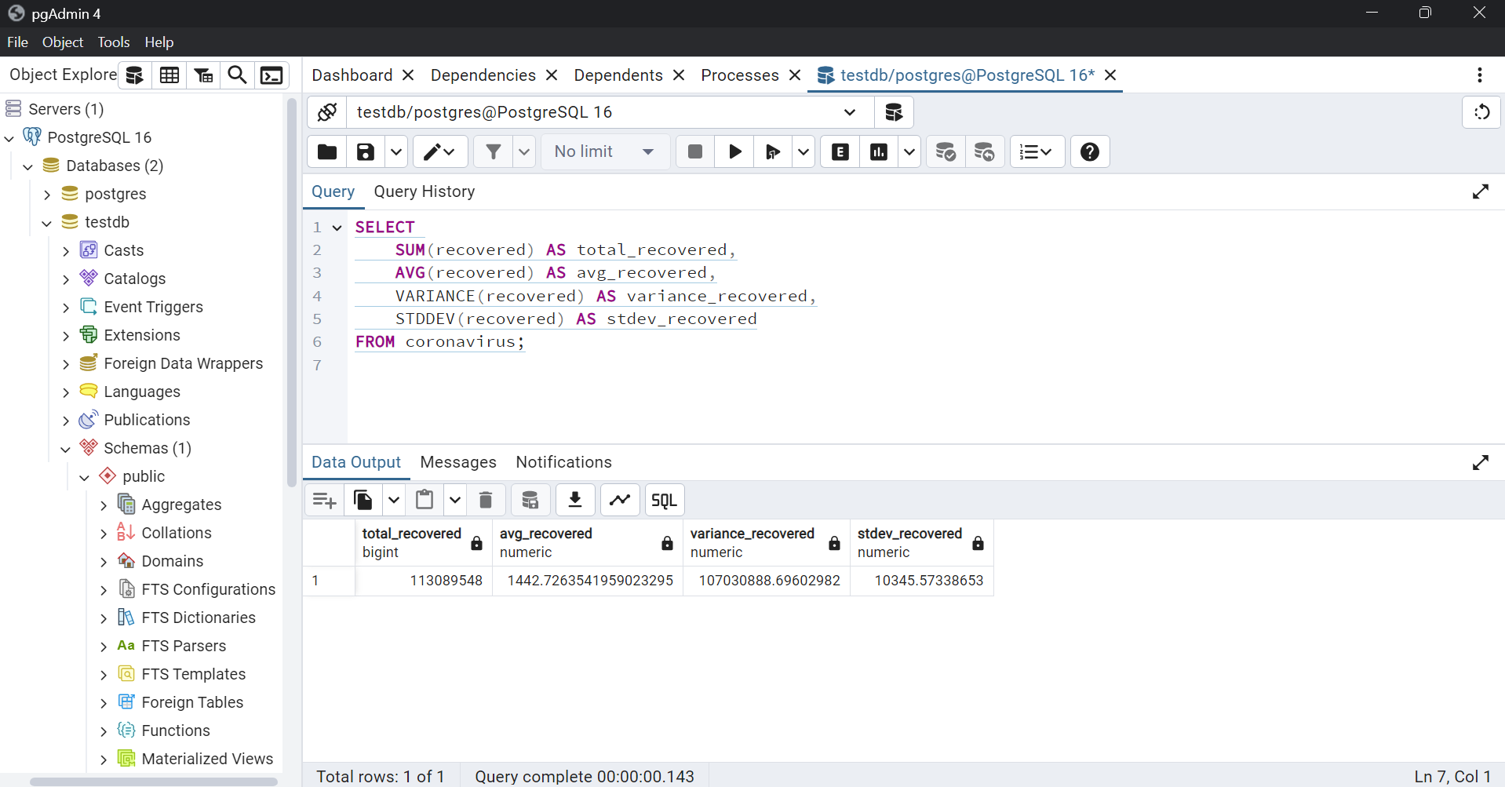
Q13. Check how corona virus spread out with respect to recovered case

Slide 18
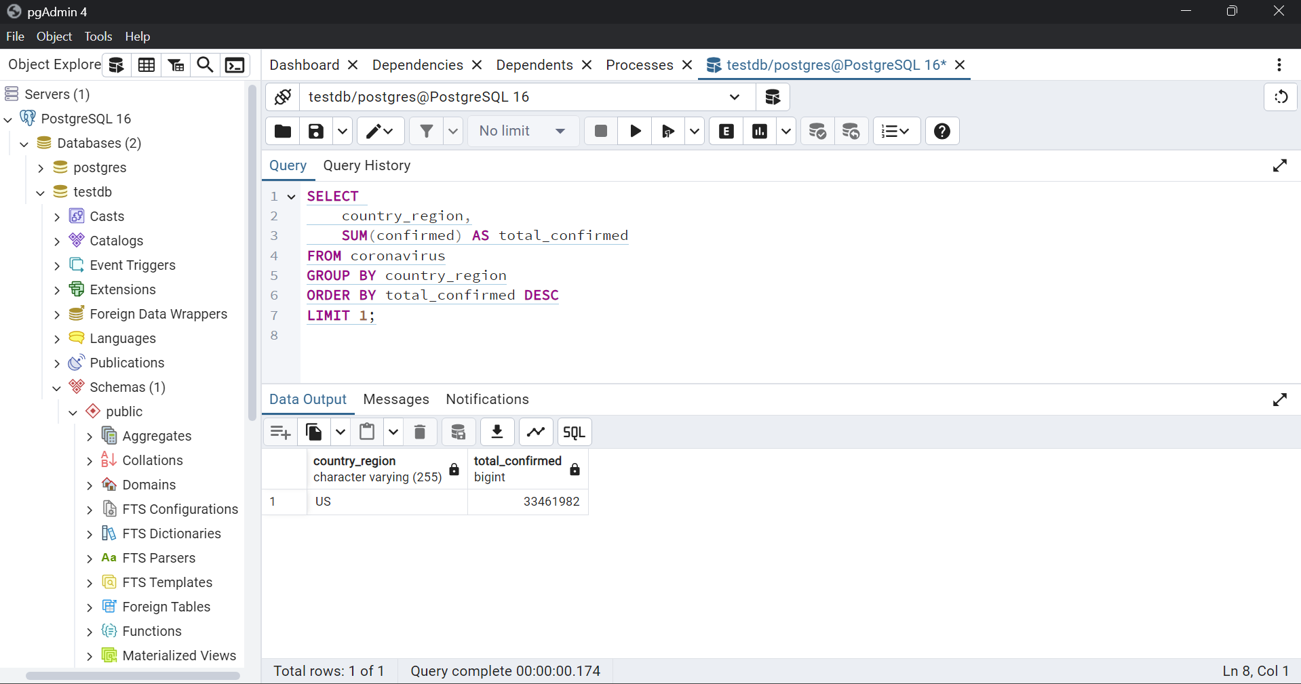
Q14. Find Country having highest number of the Confirmed case

Slide 19
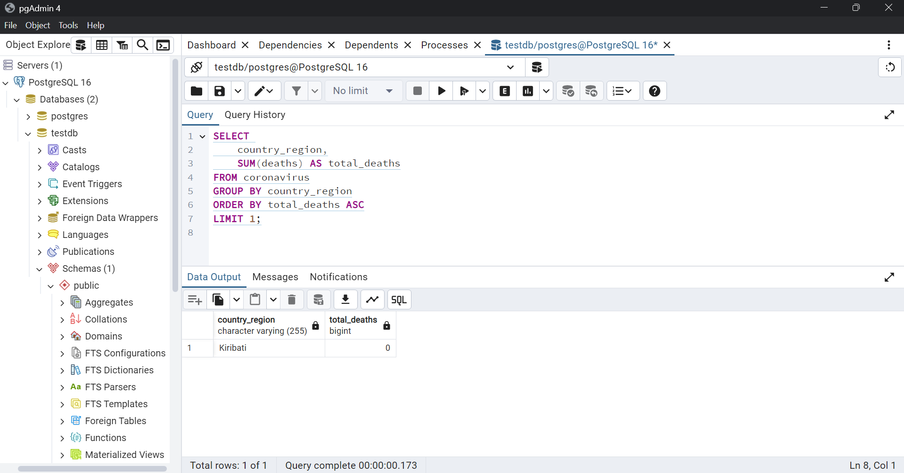
Q15. Find Country having lowest number of the death case

Slide 20
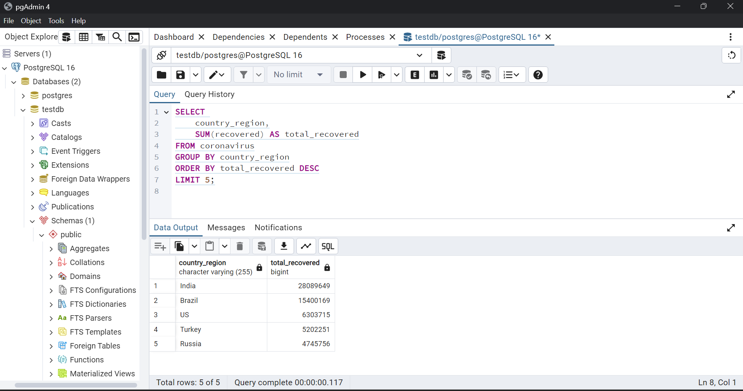
Q16. Find top 5 countries having highest recovered case

Slide 21
THANKS

